Slide 1
Query Processing & Query Optimization
Prepared By: Amrin Shaikh

Slide 2
Overview
Query Processing: range of activities involved in extracting data from a database.
Translate a given query into internal form (Similar to parser)
In generating internal form of the query parser checks syntax , verifies relation names,
System construct parse tree
Then translate relational algebra expression.

Slide 3
Basic Steps in Query Processing
1. Parsing and translation
2. Optimization
3. Evaluation

Slide 4
Basic Steps in Query Processing (Cont.)
Parsing and translation
translate the query into its internal form. This is then translated into relational algebra.
Parser checks syntax, verifies relations
Evaluation
The query-execution engine takes a query-evaluation plan, executes that plan, and returns the answers to the query.

Slide 5
There are many methods to compute answer.
Each sql query can itself translated into relational algebra expression in several ways
Ex: select salary from instructor where salary < 75000
Relational algebra could be:
σ_{salary<75000}(∏_{salary}(instructor))
is equivalent to
∏_{salary}(σ_{salary<75000}(instructor))
Sequence of operations that can be used to evaluate query is query execution plan or query evaluation plan.
Query execution engine takes a query execution plan , execute plan and return answer to query

Slide 6
Different evaluation plan for a given query can have different cost.
Don’t expect user to write query in most efficient way. It is the responsibility of system to construct query execution plan that minimize cost of query evaluation called query optimization.
To optimize query , optimizer must know the cost of each operation. But It is hard to calculate exact cost.
Disk access time
CPU time (hard to compute low level detail)
Communication cost
Whether system is distributed or parallel

Slide 7
Measures of Query Cost
Cost is generally measured as total elapsed time for answering query
Many factors contribute to time cost
disk accesses, CPU, or even network communication
Typically disk access is the predominant cost, and is also relatively easy to estimate. Measured by taking into account
Number of seeks * average-seek-cost
Number of blocks read * average-block-read-cost
Number of blocks written * average-block-write-cost
Cost to write a block is greater than cost to read a block
data is read back after being written to ensure that the write was successful

Slide 8
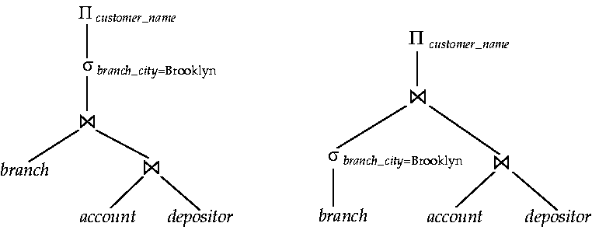
Alternative ways of evaluating a given query
Equivalent expressions
Different algorithms for each operation

Slide 9
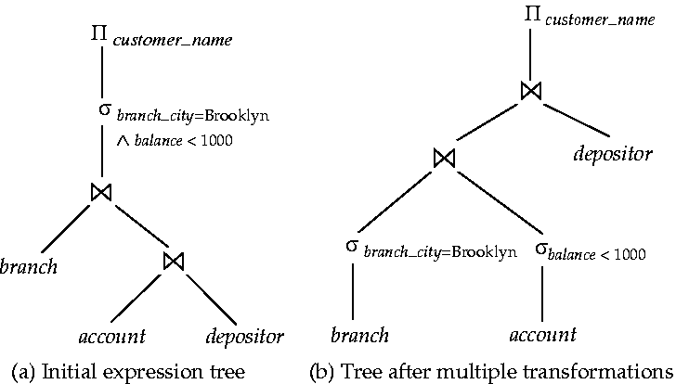

Slide 10
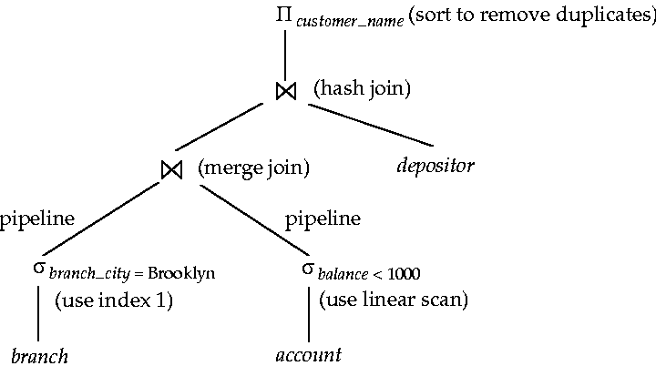
An evaluation plan defines exactly what algorithm is used for each operation, and how the execution of the operations is coordinated.

Slide 11
Cost difference between evaluation plans for a query can be enormous
E.g. seconds vs. days in some cases
Steps in cost-based query optimization
Generate logically equivalent expressions using equivalence rules
Annotate resultant expressions to get alternative query plans
Choose the cheapest plan based on estimated cost
Estimation of plan cost based on:
Statistical information about relations. Examples:
number of tuples, number of distinct values for an attribute
Statistics estimation for intermediate results
to compute cost of complex expressions
Cost formulae for algorithms, computed using statistics

Slide 12
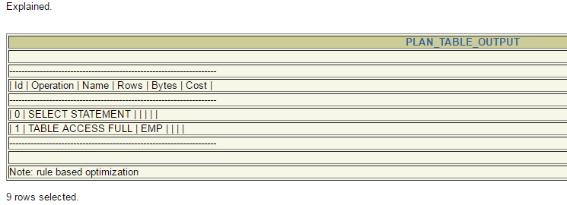
Query in oracle: example:1
set serveroutput on;
explain plan for select * from emp;
SELECT PLAN_TABLE_OUTPUT FROM TABLE(DBMS_XPLAN.DISPLAY());

Slide 13
example:2
select * from deposit_042;
CREATE TABLE deposit_011
PARTITION BY RANGE(adate)
(
PARTITION emp_p1 VALUES LESS THAN (TO_DATE('1-JAN-1992','DD-MON-YYYY')),
PARTITION emp_p2 VALUES LESS THAN (TO_DATE('1-JAN-1994','DD-MON-YYYY')),
PARTITION emp_p3 VALUES LESS THAN (TO_DATE('1-JAN-1996','DD-MON-YYYY')),
PARTITION emp_p4 VALUES LESS THAN (TO_DATE('1-JAN-1998','DD-MON-YYYY')),
PARTITION emp_p5 VALUES LESS THAN (TO_DATE('1-JAN-2001','DD-MON-YYYY'))
)
AS SELECT * FROM deposit_042;
SELECT PLAN_TABLE_OUTPUT FROM TABLE(DBMS_XPLAN.DISPLAY());

Slide 14
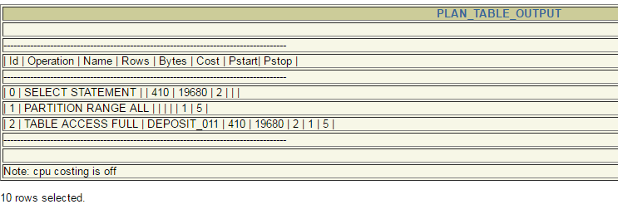

Slide 15
Thank You

